Slide 1
AWS CLOUDFRONT(CDN)
-Mukesh R

Slide 2
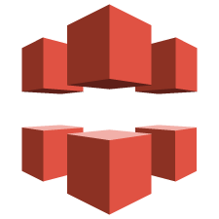



What is AWS Cloud Front?
AWS Cloud Front is a globally-distributed network offered by Amazon Web Services
Cloud Front CDN (Computer Delivery Network) is a system of distributed servers that deliver web pages and other web content to a user based on the geographic locations of the user, the origin of the webpage and a content delivery server.
such as software, SDKs, videos, etc., to the clients, with high transfer speed.
CloudFront Download streaming edge location
Distribution Distribution

Slide 3
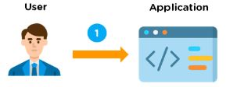

How Does AWS CloudFront Work?
There are 6 steps, how CloudFront delivers the content:
Step 1: Client Access
Step 2: Serve User Request

Slide 4
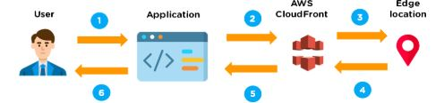
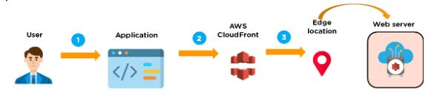
Step 3: Cache file – CloudFront
Step 4: Web server – CloudFront

Slide 5
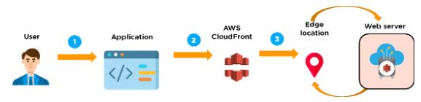
Step 5: Share file
Step 6: Receives file - CloudFront

Slide 6
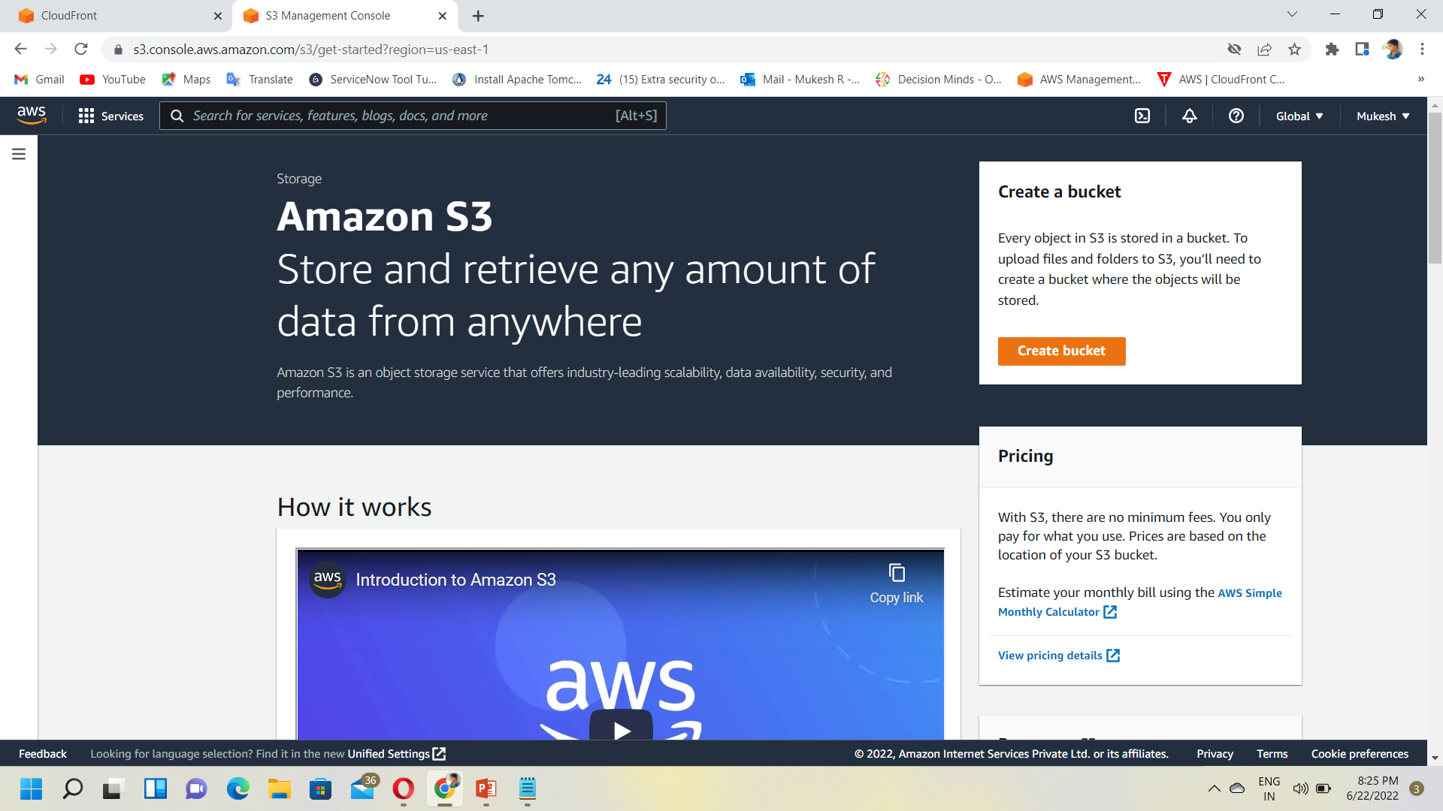
Creating a CloudFront CDN
Step 1: Create a bucket and upload content in a bucket.
Sign in to the AWS Management Console.
Click on the S3 services in the AWS
Management Console.
Click on the "Create bucket" button.

Slide 7
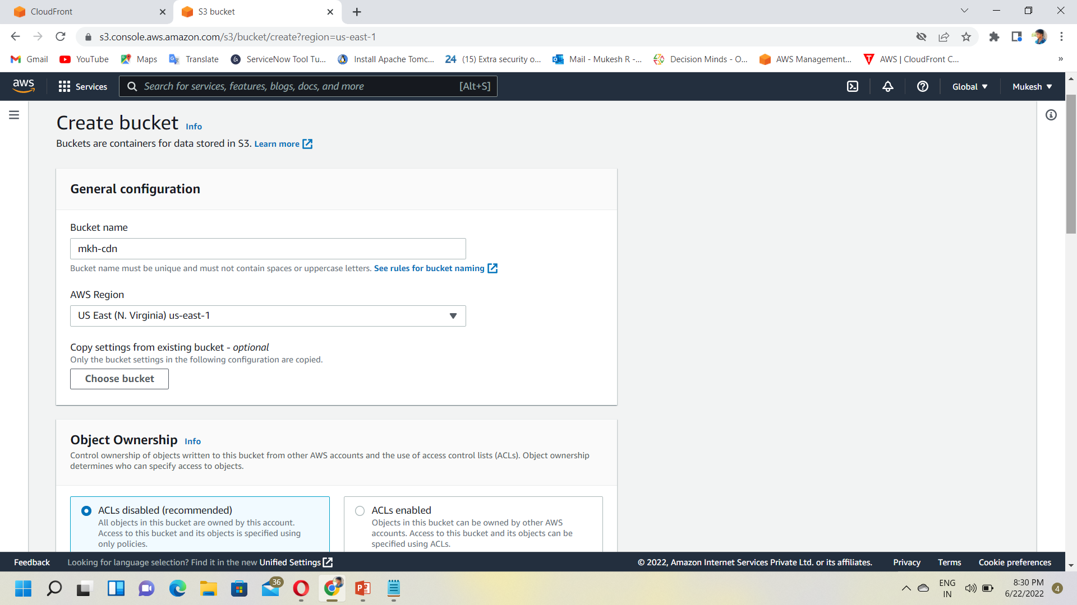
I have provided “mkh-cdn" as a bucket name.
Choose a region for your bucket.
By default, Amazon S3 bucket stores the object in the US East (N.Verginia) region.
Click on the Create button.
Select your bucket and then click on the Upload button.
Click on the Add files and select the file from your device that you want to upload.
Enable public access to the object that has been uploaded successfully.
After uploading a file, you can navigate to the object by using a URL given below:
https://mkh-cdn.s3.amazonaws.com/9.jpg

Slide 8
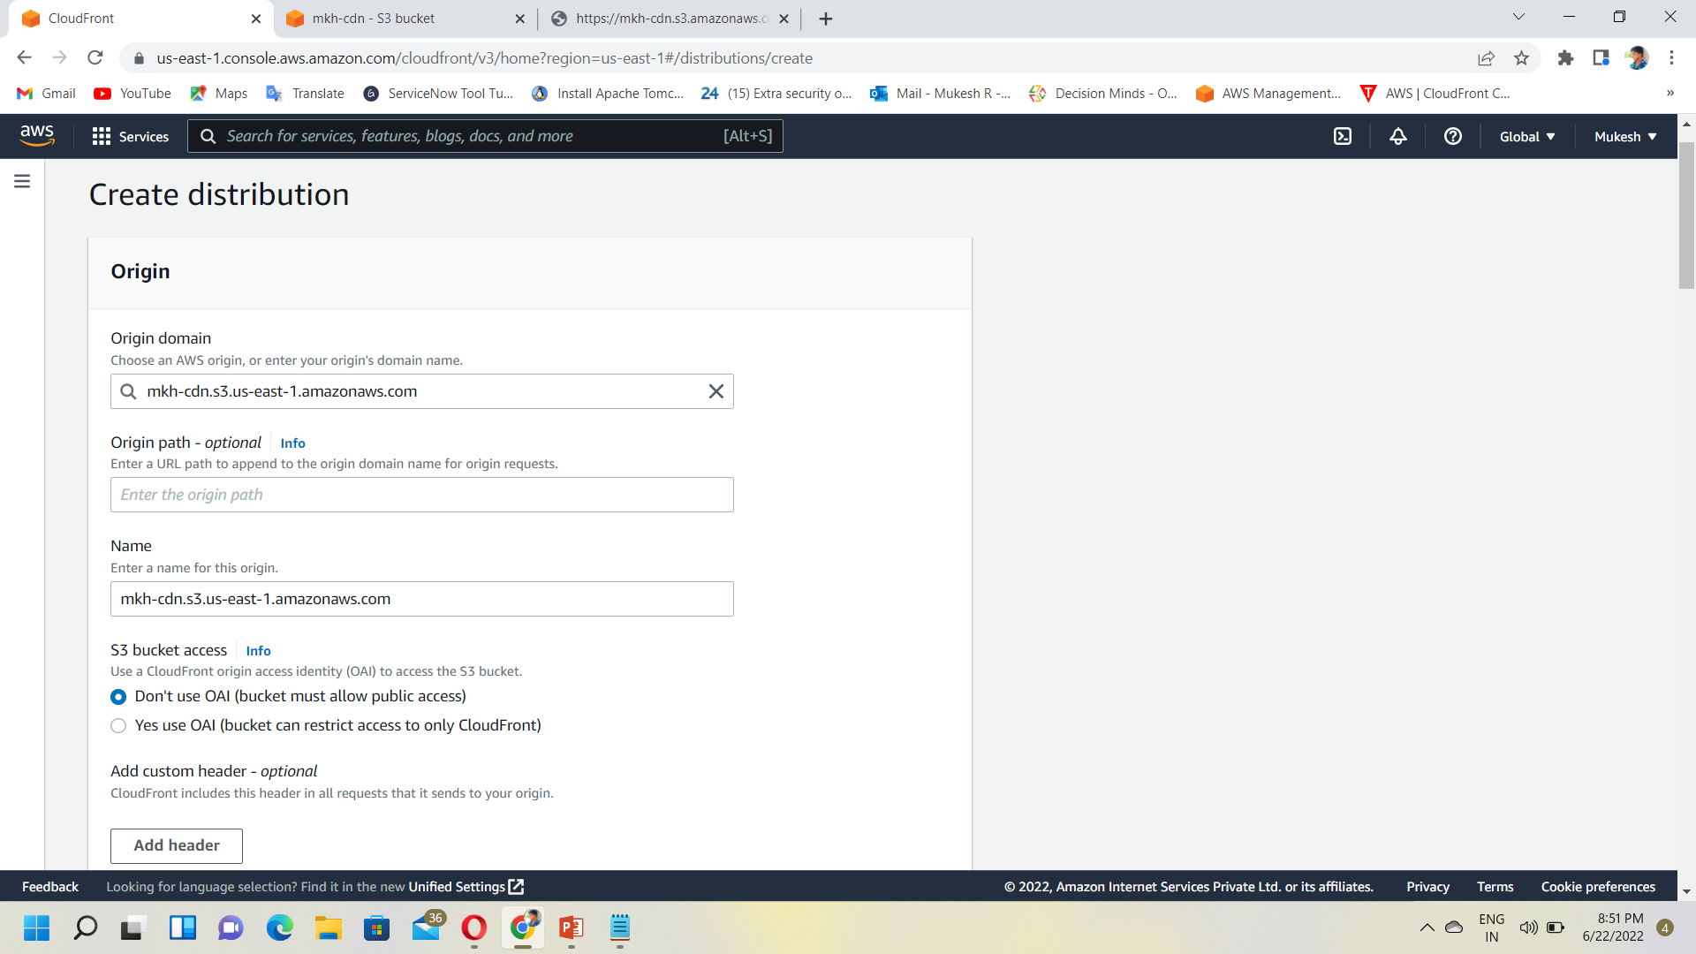
Step 2: Create a CloudFront Distribution
Open the CloudFront Console by using the link https://console.aws.amazon.com/cloudfront/.
Click on the Create Distribution
Where,
Origin Domain Name: It defines from where the origin is coming from. Origin domain name is mkh-cdn.s3.us-east-1.amazonaws.com in which mkh-cdn is a bucket that we have created in S3.
Origin Path: There can be multiple origins in a distribution. Origin path is a folder in S3 bucket. You can add the folders in S3 bucket and put it in the Origin Path, means that the origin is coming from the different folders not from the bucket itself. I leave the Origin Path with a default value.

Slide 9
Cache Behavior Settings

